Slide 1
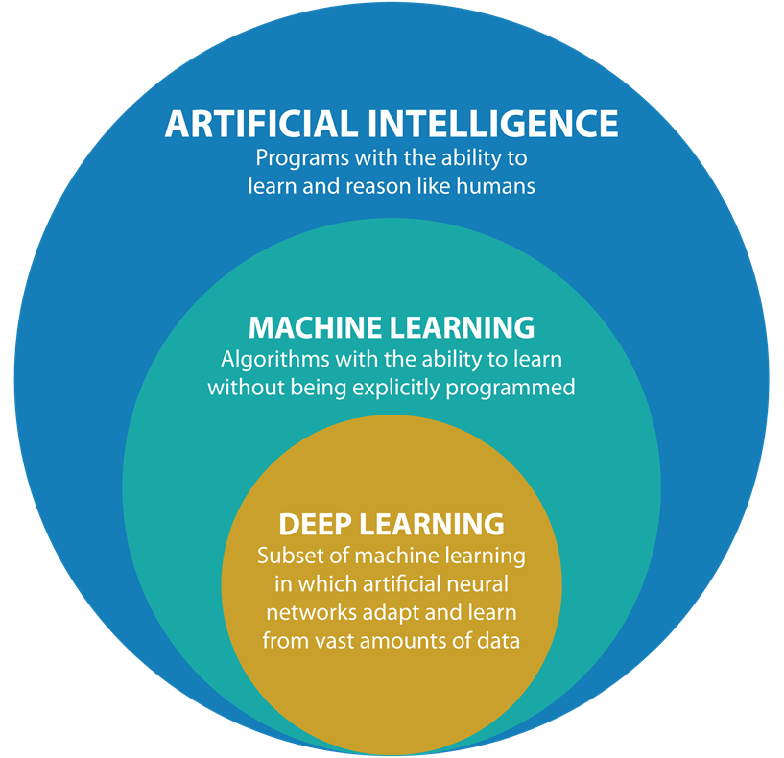
What is machine Learning

Slide 2
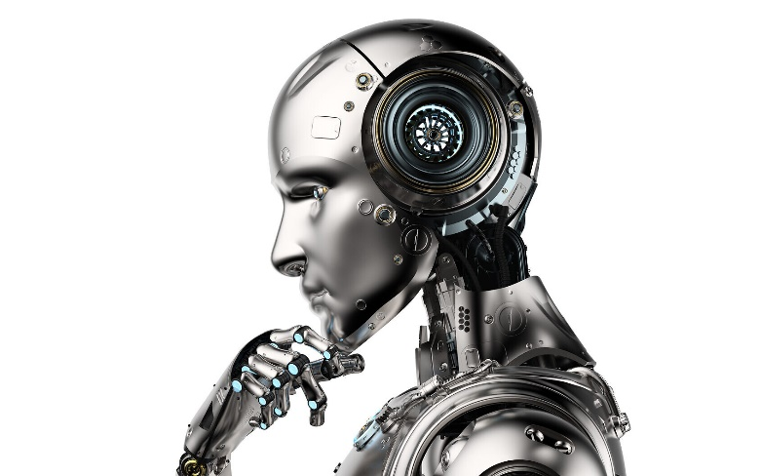
Artificial Intelligence
AI is the ability of machines to think, learn, and perform tasks that typically require human intelligence.
Examples include voice assistants like Siri or Alexa, self-driving cars, and computer vision used in security systems.

Slide 3
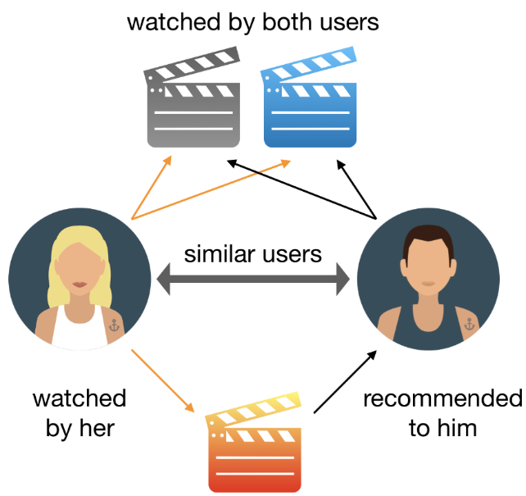

Machine Learning
ML (Machine Learning): ML is a type of AI that enables machines to learn from data without being explicitly programmed.
Examples include spam filters in email, recommendation systems like those used by Netflix or Amazon, and predictive models for weather forecasting.

Slide 4

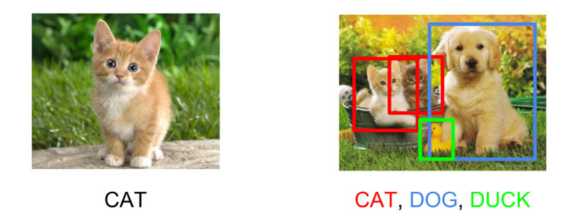
Deep Learning
DL is a subset of ML that uses artificial neural networks to learn from large amounts of data.
Examples include image and speech recognition, language translation, and medical diagnosis.

Slide 5
Data Science
Data Science: Data science is an interdisciplinary field that uses scientific methods, processes, algorithms, and systems to extract insights and knowledge from structured and unstructured data.
Examples include analyzing customer behavior in e-commerce, detecting fraud in financial transactions, and predicting disease outbreaks.
In summary, AI, ML, DL, and data science are all related to the field of technology and involve using data to enable machines to learn and perform tasks.

Slide 6
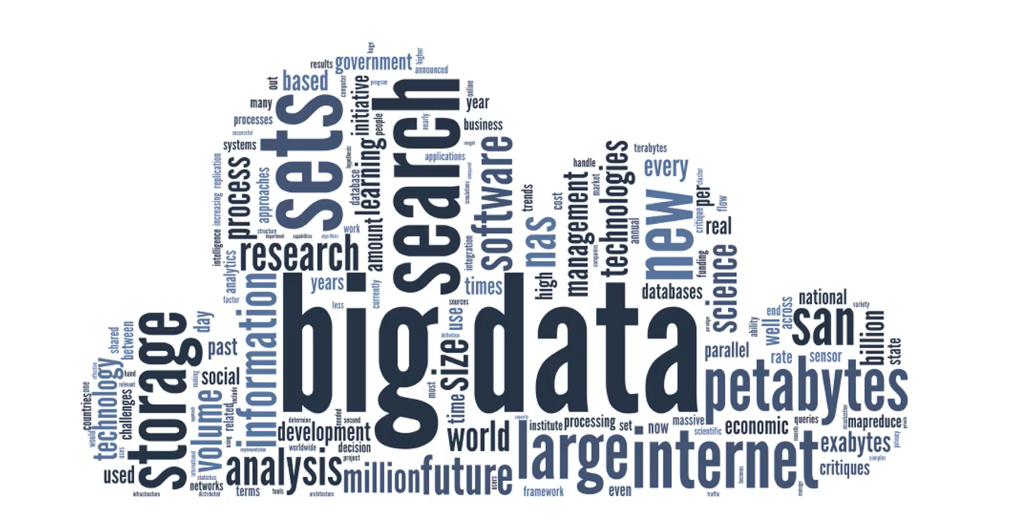
ML is a future

Slide 7
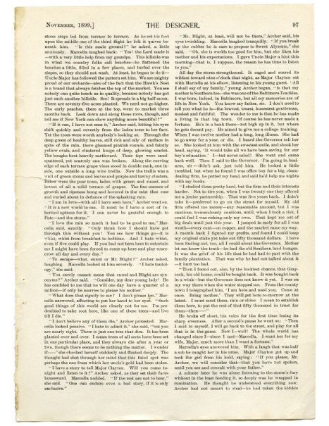
ML is a future
A
A Single letter on the computer takes 1 Byte of data
A single page of the book with 1000 characters takes 1000 Byte of data. i.e 1kB
Up until 2005… humans had created 130 exabytes of data

Slide 8

ML is a future
Up until 2005… humans had created 130 exabytes of data
Whole life of a person can
be recorded into 1 terabyte (1000 gb)of memory

Slide 9
ML is a future
2005 – 130 EXABYTES
2010 – 1200 EXABYTES
2015 – 7900 EXABYTES
2020 – 40900 EXABYTES
Up until 2005… humans had created 130 exabytes of data

Slide 10
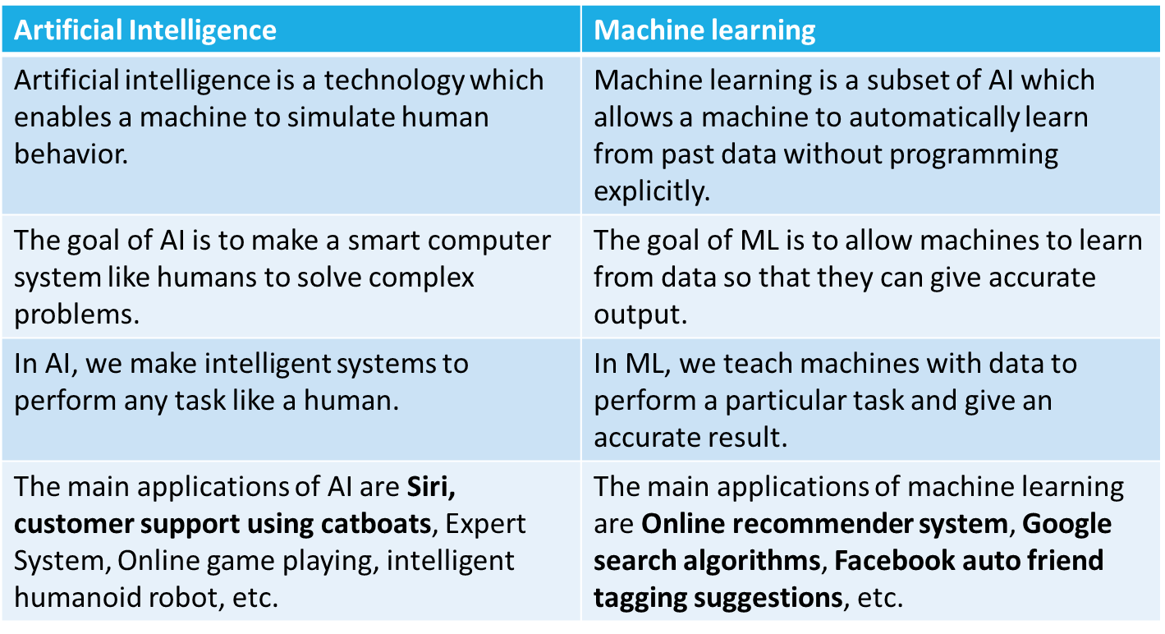
Difference: Artificial Intelligence (AI) and Machine learning (ML)
Up until 2005… humans had created 130 exabytes of data

Slide 11
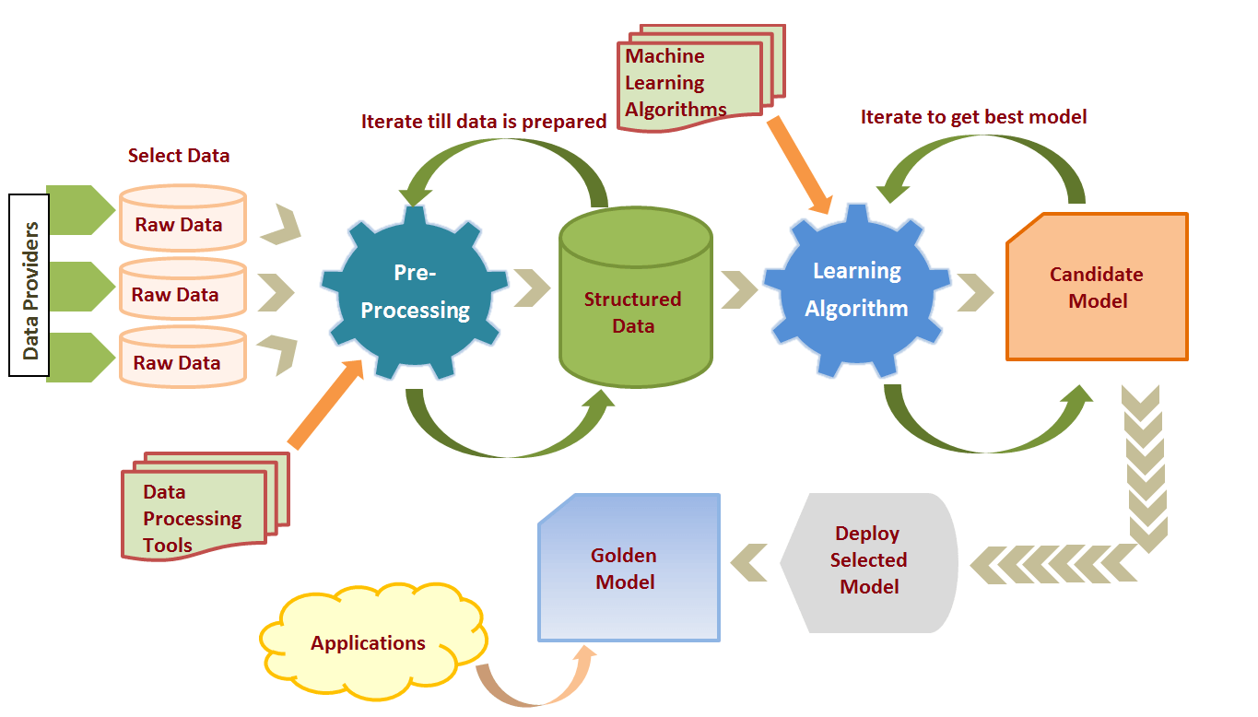
Machine Learning Process
Up until 2005… humans had created 130 exabytes of data

Slide 12
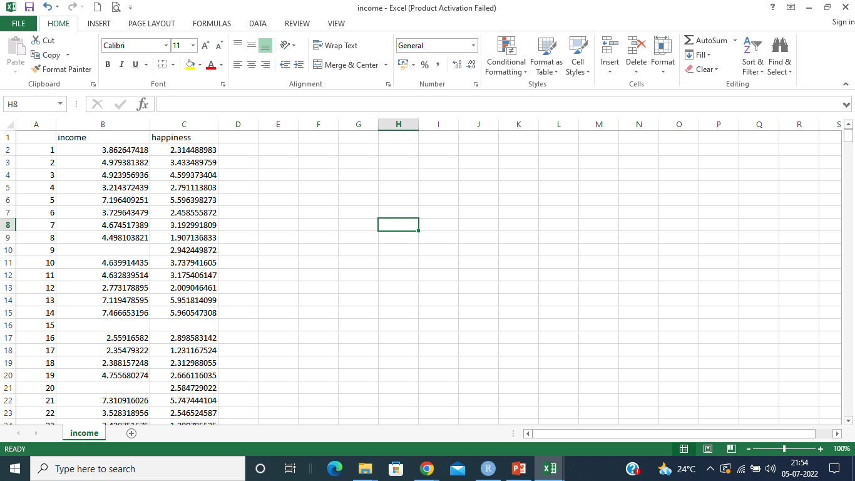
Step 1 (Define business requirement): Predict happiness of a person based on his income
Step 2 (Data Collection) : Collect a data suitable for analysis
Up until 2005… humans had created 130 exabytes of data

Slide 13
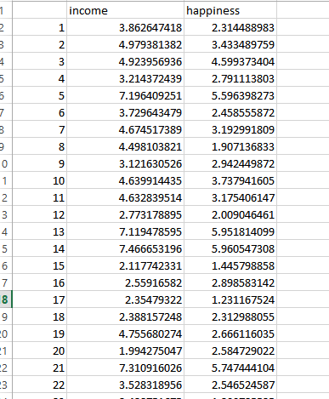
Step 3 (Data Cleaning) : Remove noise, outliers ,replace missing values using statistical measures etc.
Up until 2005… humans had created 130 exabytes of data

Slide 14
Step 4 (Data Exploration) : explore and visualize data to uncover insights , identify important data for analysis and remove the data which may distort analysis
Step 5 (Data Modelling) : Use suitable machine learning algorithm to build model. Model can be decision tree, description or any mathematical formula.
Step 6 (Deployment and optimization ) : Use model
Up until 2005… humans had created 130 exabytes of data

Slide 15
Syllabus
Unit 1 Introduction to Machine Learning
Overview – Design of a Learning System
Types of Machine Learning
Supervised Learning and Unsupervised Learning
Mathematical Foundations of Machine Learning
Applications of Machine Learning , Machine Learning Foundations
Up until 2005… humans had created 130 exabytes of data

Slide 16
Syllabus
Unit 2 Supervised Learning I- Linear regression- I
Simple Linear Regression
Multiple Linear Regression
Polynomial Regression
Ridge Regression
Lasso Regression
Up until 2005… humans had created 130 exabytes of data

Slide 17
Syllabus
Unit 3 Supervised Learning I- Linear regression- II
Evaluating Regression Models
Model Selection
Bagging
Ensemble Methods.
Unit 4 Supervised learning II:
Classification
Logistic Regression
Decision Tree Regression and Classification
Random Forest Regression and Classification
Support Vector Machine Regression and Classification
Evaluating Classification Models.
Up until 2005… humans had created 130 exabytes of data

